Slide 1
CONTENTS
ABSTRACT
INTRODUCTION
LITERATURE SURVEY
PROPOSED METHODOLOGY
IMPLEMENTATION & ARCHITECTURE
RESULTS AND DISCUSSION
CONCLUSION AND FUTURE SCOPE
REFERENCES

Slide 2
ABSTRACT
This Power point will present a comprehensive overview of a Python project designed to address food waste management through calorie estimation of food and beverages using deep learning. Users log in to the system, upload pictures of their food, and receive detailed nutritional reports. This project aims to help users make informed dietary choices, thereby reducing food waste. The project incorporates various Python libraries such as NumPy, Pillow, Keras, TensorFlow, Flask, pandas, and matplotlib to achieve its objectives.

Slide 3
INTRODUCTION
Food waste is a significant global issue, contributing to environmental degradation and economic loss. This project leverages deep learning technology to estimate the caloric content of food items from images, encouraging users to manage their diet more effectively. By reducing food waste, we aim to promote sustainable living practices.
Users are required to log in to access the system. Once authenticated, they can upload images of food and beverages. The system uses deep learning models to analyze the images and estimate their caloric content. This information is then presented in a detailed nutrition report, enabling users to make better dietary decisions.

Slide 4
LITERATURE SURVEY
S.No. | Name of Author | Title of the paper | International journal/conference | Volume No. | Issue | ISBN/ ISSN
1. | Ahmed Farhadi, J., & Harandi, M. T | Deep learning for food image recognition and dietary assessment | IEEE international Conference on image processing (ICP) | 26 | 2018 | ISSN 1522-4880
2. | Martin, C. K., & Nicklas, T. A. | Validation of Image-Based Dietary Assessment Using Deep Learning | Journal of the Academy of Nutrition and Dietetics | 118 | 2015 | ISBN 978-1-4673-8391-2
3. | Kawano, Y., & Yanai, K. | Automatic Calorie Estimation of Food Images on a Smartphone | IEEE International Conference on Multimedia and Expo (ICME) | 20 | 2017 | ISSN 1520-9210ISSN 1520-9210

Slide 5
PROPOSED METHODOLOGY
Step 1: User Authentication and Interface Design
Step 2: Image Upload and Preprocessing
Step 3: Deep Learning Model Development
Step 4: Training and Evaluation
Step 5: Integration with Flask Backend
Step 6: Nutrition Report Generation
Step 7: Testing and Debugging
Step 8: Deployment and Maintenance
Notes:
Step 1: User Authentication and Interface Design
The first step involves developing a secure and user-friendly authentication system. Users must be able to create accounts and log in to access the application's features. The interface will be designed using HTML, CSS, and JavaScript to ensure a smooth user experience. The interface will include options for users to upload images of food and beverages, submit these images, and receive nutrition reports.
Step 2: Image Upload and Preprocessing
Once authenticated, users can upload images of their food and beverages. These images will undergo preprocessing using the Pillow library to standardize their format and size. Preprocessing steps include resizing, normalization, and conversion to grayscale or other formats suitable for the deep learning model.
Step 3: Deep Learning Model Development
The core of the project involves developing a deep learning model using Keras and TensorFlow. A convolutional neural network (CNN) will be designed and trained to recognize food items and estimate their caloric content. The model will be trained on a large dataset of food images, with annotations for nutritional information. Techniques such as data augmentation, dropout, and regularization will be employed to enhance the model's accuracy and prevent overfitting.
Step 4: Training and Evaluation
The CNN model will be trained using the preprocessed dataset. Training involves adjusting the model’s parameters to minimize the error in calorie estimation. Various hyperparameters, such as learning rate, batch size, and the number of epochs, will be tuned to optimize the model's performance. The model’s accuracy will be evaluated using metrics like precision, recall, and F1-score. Cross-validation will be used to ensure the robustness of the model.
Step 5: Integration with Flask Backend
The trained deep learning model will be integrated into a Flask-based backend. Flask will handle user requests, process uploaded images, and invoke the deep learning model for inference. When a user uploads an image and submits it for recognition, the backend will process the image and generate a caloric estimate.
Step 6: Nutrition Report Generation
The estimated caloric content and other nutritional information will be compiled into a detailed nutrition report. This report will be displayed to the user through the web interface. The report will include visualizations generated using pandas and matplotlib, providing users with a clear and comprehensive understanding of their food's nutritional content.
Step 7: Testing and Debugging
Comprehensive testing will be conducted to ensure the reliability and accuracy of the system. Unit tests will be written for individual components, while integration tests will verify that all parts of the system work together seamlessly. User testing will provide feedback on the application's usability and performance. Debugging tools and techniques will be used to identify and resolve issues, ensuring a smooth user experience.
Step 8: Deployment and Maintenance
After thorough testing, the application will be deployed on a web server. Regular maintenance will be conducted to address any issues that arise post-deployment. The system will be monitored for performance, and updates will be made to improve functionality and user experience.

Slide 6
IMPLEMENTATION & ARCHITECTURE
System Architecture
The system architecture for the food waste management project is designed to be modular and scalable, consisting of several key components:
User Interface (UI)
Backend
Image Processing Module
Deep Learning
Database
Nutrition Report
Notes:
User Interface (UI): The frontend of the web application where users interact with the system.
Backend Server: The core of the application, handling user authentication, image uploads, and deep learning model inference.
Image Processing Module: Preprocesses the uploaded images to ensure they are in a suitable format for analysis.
Deep Learning Model: The trained convolutional neural network (CNN) that performs the calorie estimation.
Database: Stores user information, session data, and possibly historical nutrition reports.
Nutrition Report Generator: Compiles and presents the caloric and nutritional information in a user-friendly format.

Slide 7
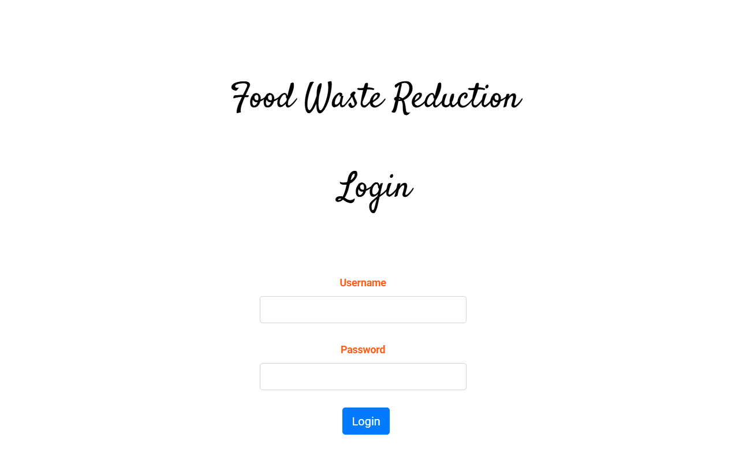
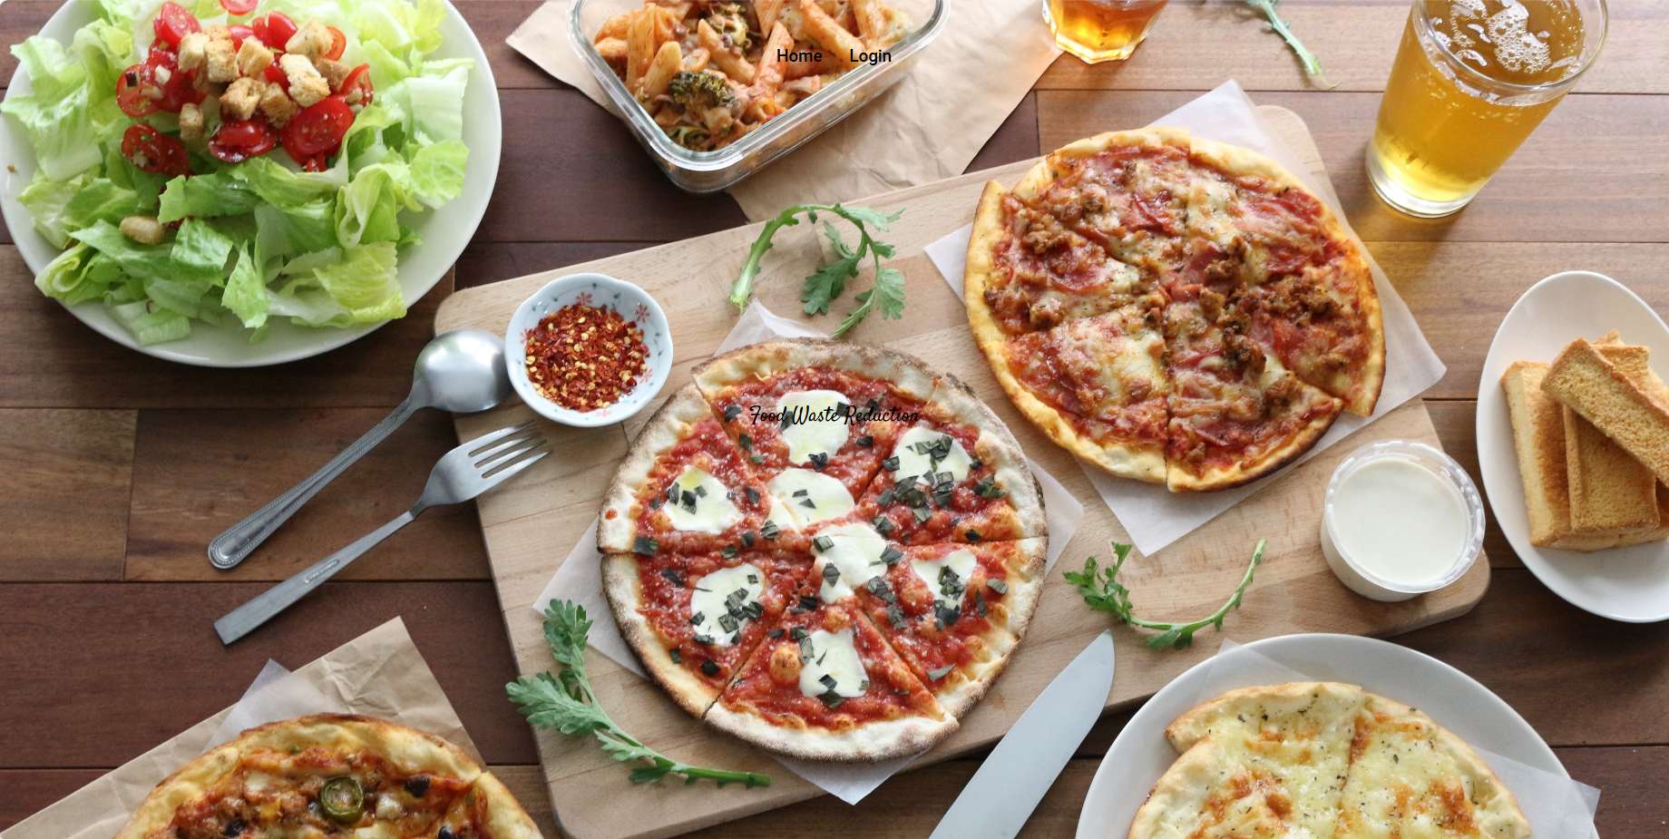
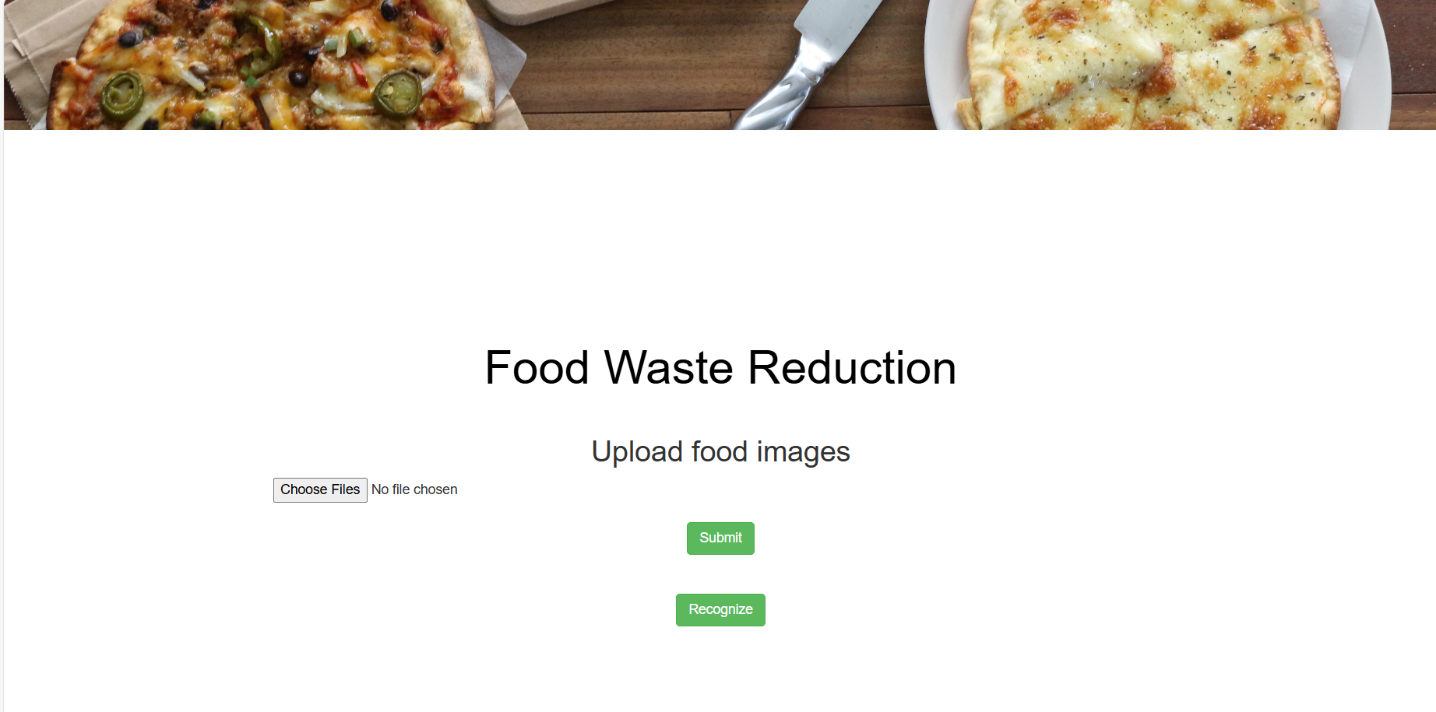
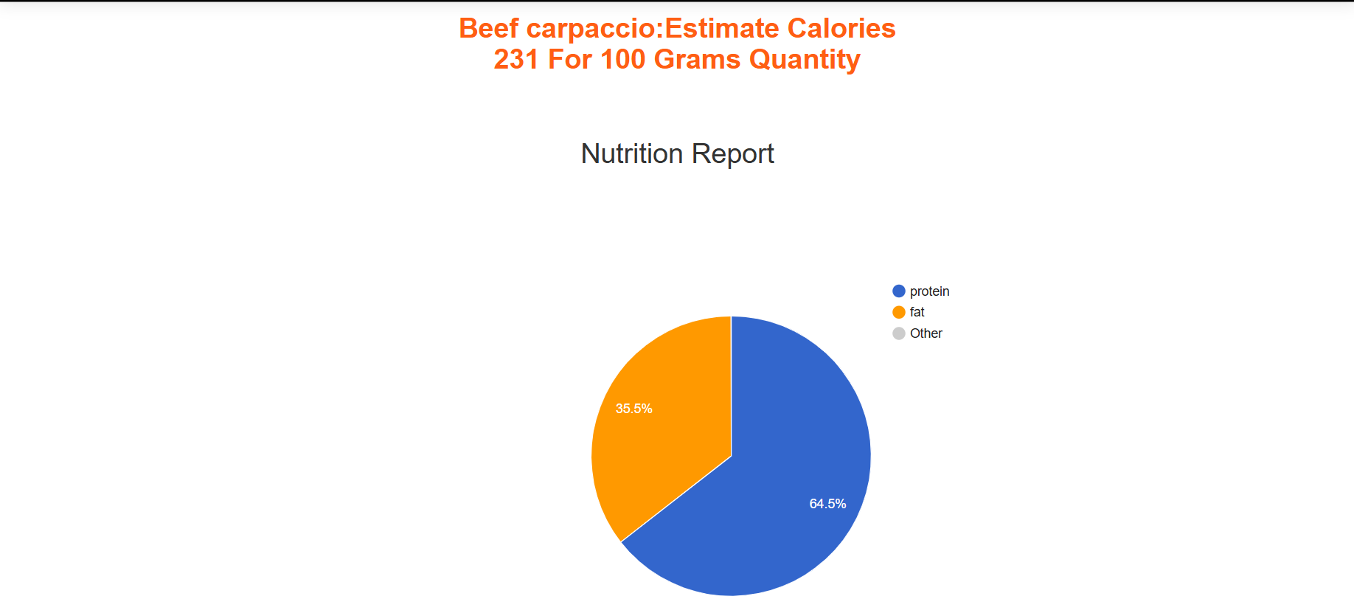
RESULTS & DISCUSSION

Slide 8
CONCLUSION AND FUTURE SCOPE
This project successfully integrates deep learning technology to address the critical issue of food waste management by providing users with an intuitive tool to estimate the caloric content of food and beverages from images. The system's architecture, combining user authentication, image processing, and nutrition analysis, ensures a seamless user experience.
The future scope of this project includes expanding the dataset to cover a wider variety of food items and regional cuisines, thereby improving the model's accuracy and applicability. Integrating additional nutritional parameters, such as macronutrients and micronutrients, can provide more comprehensive dietary insights. Enhancing the user interface with personalized recommendations and meal planning features can further engage users.

Slide 9
REFERENCES
FAO. (2011). Global food losses and food waste – Extent, causes and prevention. Rome.
LeCun, Y., Bengio, Y., & Hinton, G. (2015). Deep learning. Nature, 521(7553), 436-444.
Simonyan, K., & Zisserman, A. (2015). Very deep convolutional networks for large-scale image recognition. ICLR.
He, K., Zhang, X., Ren, S., & Sun, J. (2016). Deep residual learning for image recognition. CVPR.
Zeiler, M. D., & Fergus, R. (2014). Visualizing and understanding convolutional networks. ECCV.
Chollet, F. (2017). Deep Learning with Python. Manning Publications.
Kingma, D. P., & Ba, J. (2015). Adam: A method for stochastic optimization. ICLR.

Slide 10
Q&A

Slide 11
THANK YOU

